Slide 1
Winery Group Presentation
Ashton Stoelk, Daniel Szabo, Isaac McSorley, Xiang Liu

Slide 2
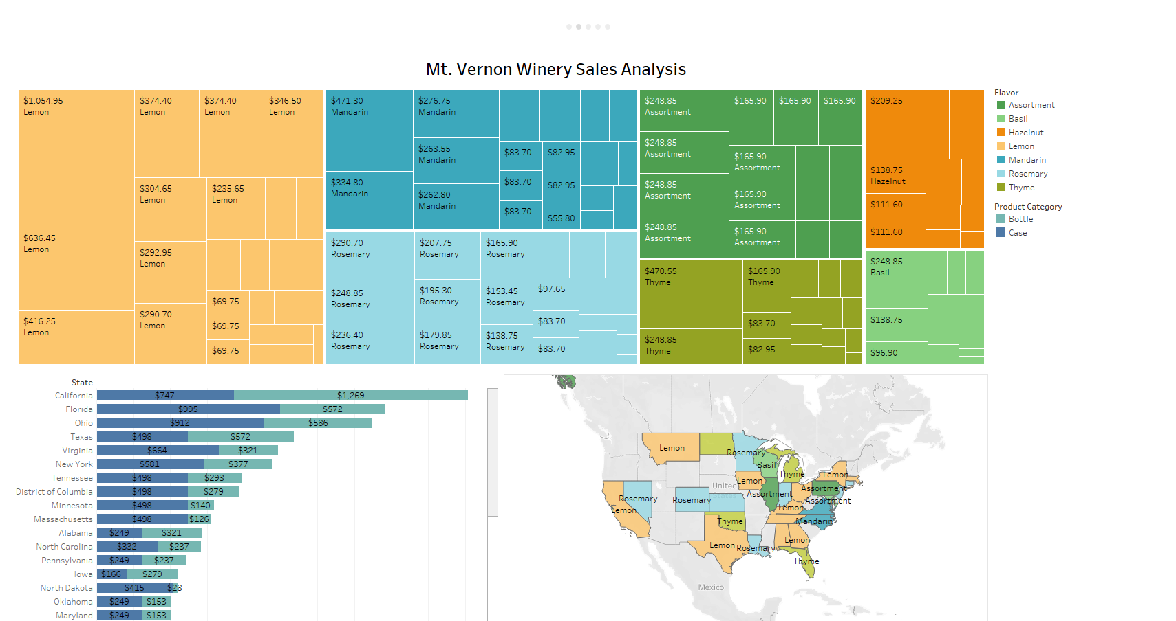

Slide 3
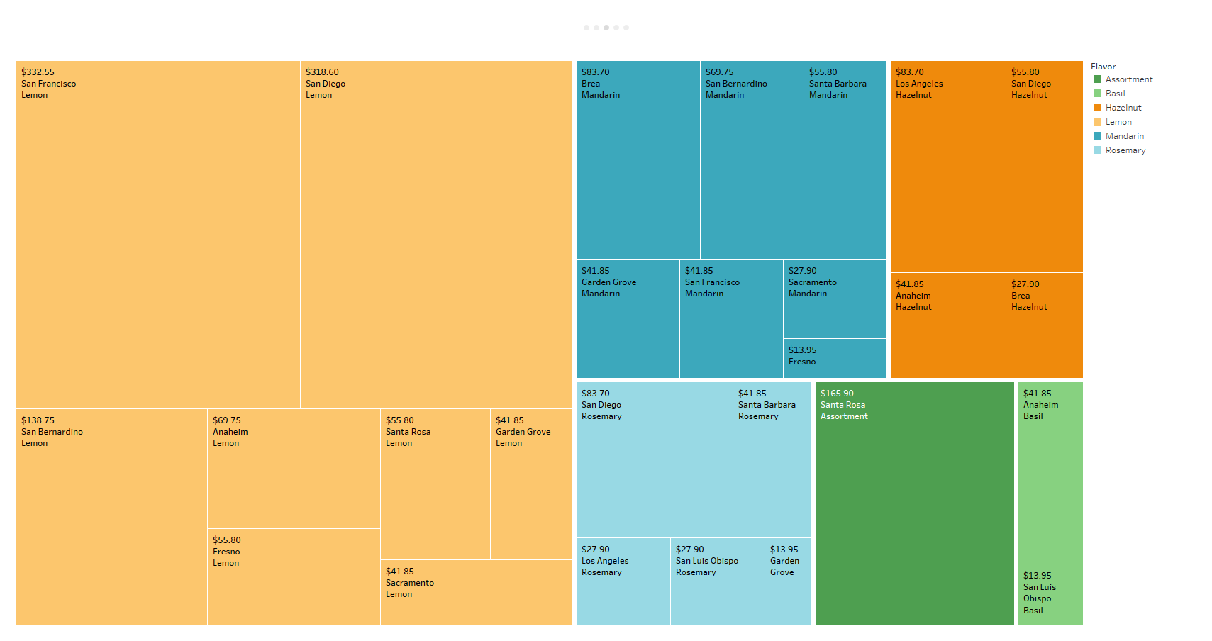

Slide 4
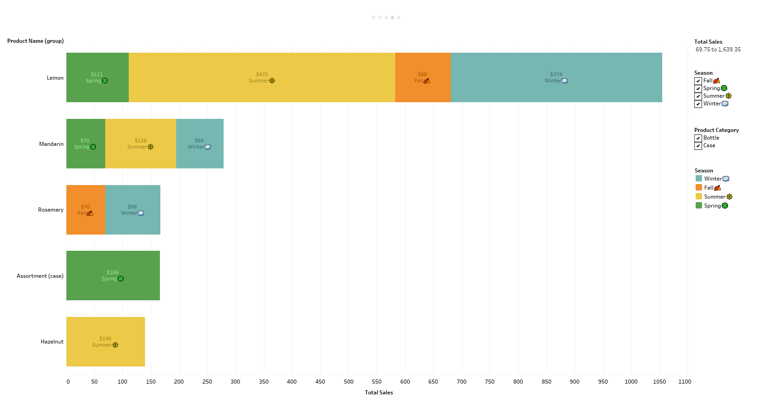

Slide 5
